Slide 1
Protein-Protein Docking
Exploring the tools and techniques

Slide 2
Agenda
Introduction to Docking
Docking methods
Docking tools
Optimization
Scoring
Architecture
Evaluation
Visualization
Schedule and work distribution

Slide 3
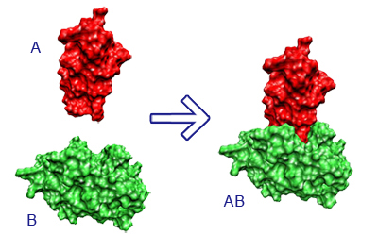
Introduction to Docking
Protein docking is used to predict the orientation in which proteins dock
Useful in drug creation and disease prevention
Synthetic proteins can be created if docking can be predicted
?

Slide 4
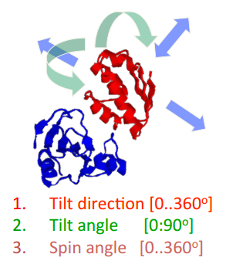
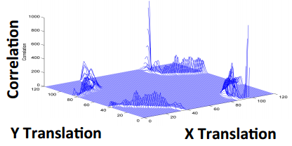
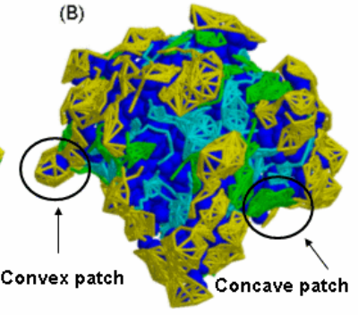
Docking methods
Many methods are currently used, from domain specific to out of left field
Common methods:
Fast Fourier Transform – background in mathematics and engineering
Geometrics Hashing – 3D “puzzle” that comes from computer graphics
Markov Chain Monte Carlo – data driven approach

Slide 5
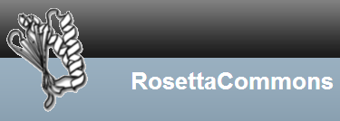


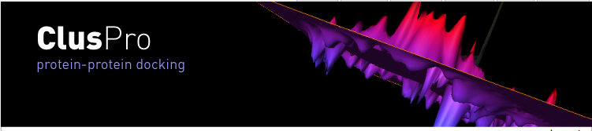

Docking tools
RosettaDock (Server & Download) – 2 PDBs to 1 PDB
Monte Carlo perturbations
HADDOCK (Server) – 2 PDBs to 1 PDB
Data driven simulations
Uses known structures and interactions to train
Zdock (Server) – 2 PDBS to 1 PDB
FFT
Zdock scoring
ClusPro (Server) – 2 PDBS to 1 PDB
Filters based on clustering
Dot (Download) – 2 DOT files to 1 PDB
Fix one protein, align the second
Hex (Download) – 2 PDBs to 1 PDB
Spherical Polar Fourier
The list goes on

Slide 6
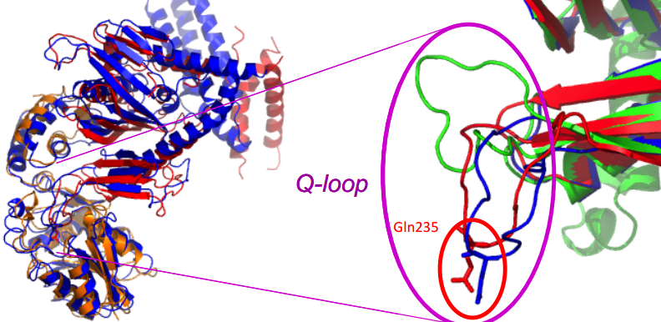
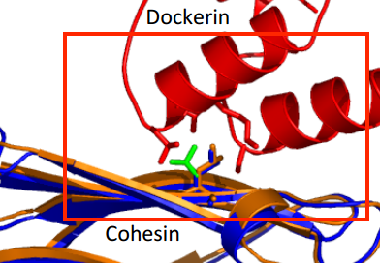
Optimization
Many methods can be used for optimization
Side chain flexibility – minor computational complexity
Backbone flexibility – major computational complexity
Hydrophobic levels of hidden residues – data complexity (need a lot of it!)
More and more are introduced as computational power continues to grow

Slide 7
Scoring
Similar to structure prediction: many choices available
For known structures, however, rmsd may not be preferred
Instead, focus on the interface:
Rmsd of predicted interface vs native
Predicted residue-residue contacts in interface vs native
TM-Score of PDBs of interfaces only (similar to option 1)

Slide 8
Architecture
TODO – Visualize
Generate Decoys from Servers (2-3 servers)
Score Decoys using Zdock and Rosetta
Using top 100, optimized using RosettaDock
Score optimized decoys using Zdock and Rosetta
Plot decoys from un-optimized and optimized groups
(rmsd | % compliance) vs (zdock | rosetta)
4 plots per decoy group
Visualize top model from each group w/ score
Repeat for next target

Slide 9
Server 1
Hex
Ranking
Rosetta
Server 2
ClusPro
Optimization
Rosetta
Server 3
ZDOCK
Ranking
Rosetta
Visualization
Chimera

Slide 10
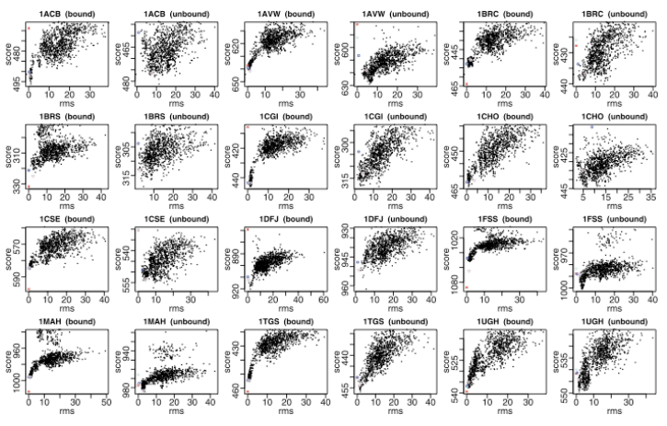
Evaluation
Rmsd of interfaces
% similarity between predicted residue-residue interface sequence and native interface
Un-optimized vs Optimized predictions
Score (Zdock, RosettaDock, etc.) vs rmsd and similarity will be used for both optimized and un-optimized predictions for comparison
Example: Score vs RMSD across multiple targets

Slide 11
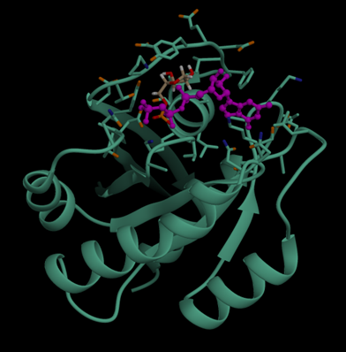
Visualization
Scatter plots will be used to visualize evaluations
Chimera will be used to show predicted docking
Example: Score vs RMSD across multiple targets

Slide 12
Schedule and work distribution
Coordinator: Sean Lander
Workload distribution: Yet to discuss
March 21: Workload distributed
March 31: Tools learned
March 31: Decoy creation started
April 2: Optimization started
April 5: Optimization complete. Evaluation started
April 6: Evaluation complete. Report started
April 7: Presentation (estimated)

Slide 13
Lecture after presentation
How do we calculate distance?
Check CAPRI site. CA-CA? Closest atoms in each residue? Defined in CAPRI
Remove all non-interface atoms to use TM score?
Reorder the two proteins to look like one
TM score can’t work on multiple chains so it has to look like a single protein
% pairs in contact in decoy that exists in native
% native contacts realized in the model
Only worry about residue index in A and B, not what residue type it is

